Slide 1

SEAM
Lopsang Lama
LC00017001209
Section: D

Slide 2
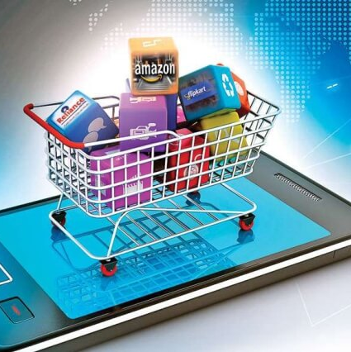
Introduction
SEAM provides a web application-based e-commerce platform for electronic applications as well as secondhand applications.
SEAM is an e-commerce web application that connects the buyer and seller through internet or online.

Slide 3
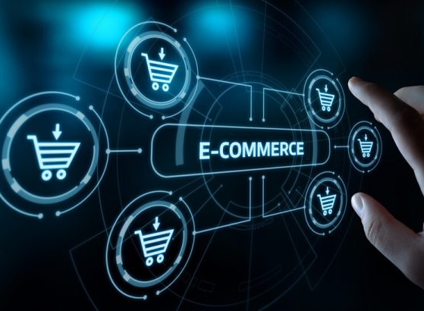
Objectives
To develop a user-friendly web application that provides a platform for buying and selling second-hand electronic applications.
To address the problems of traditional method of buying and selling electronic devices such as time-consuming, limited reach, Credibility of Seller etc.,

Slide 4

Problem
Limited range of products available in traditional market, Time-consuming, and Not knowing seller Credibility.
There are many times when buying a secondhand product, many people get scammed as the product quality will not be same as mentioned previously.

Slide 5
Why this Platform?
User-Friendly Interface
Time Saving
Fast Delivery

Slide 6
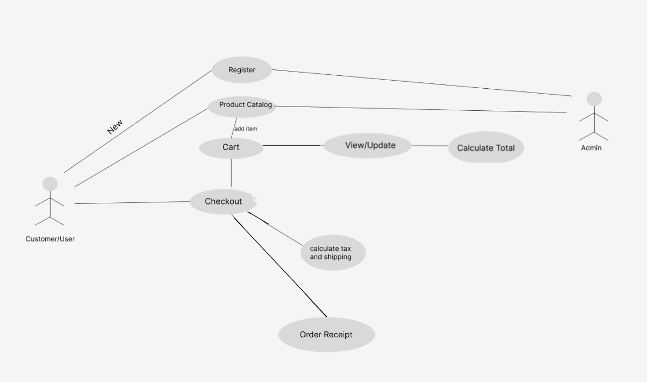
Use Case
6

Slide 7
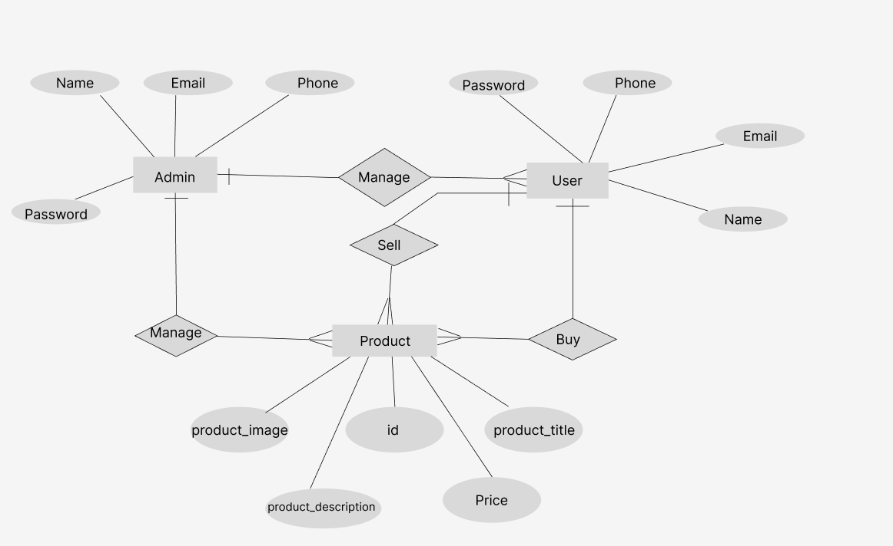
ER-DIAGRAM

Slide 8
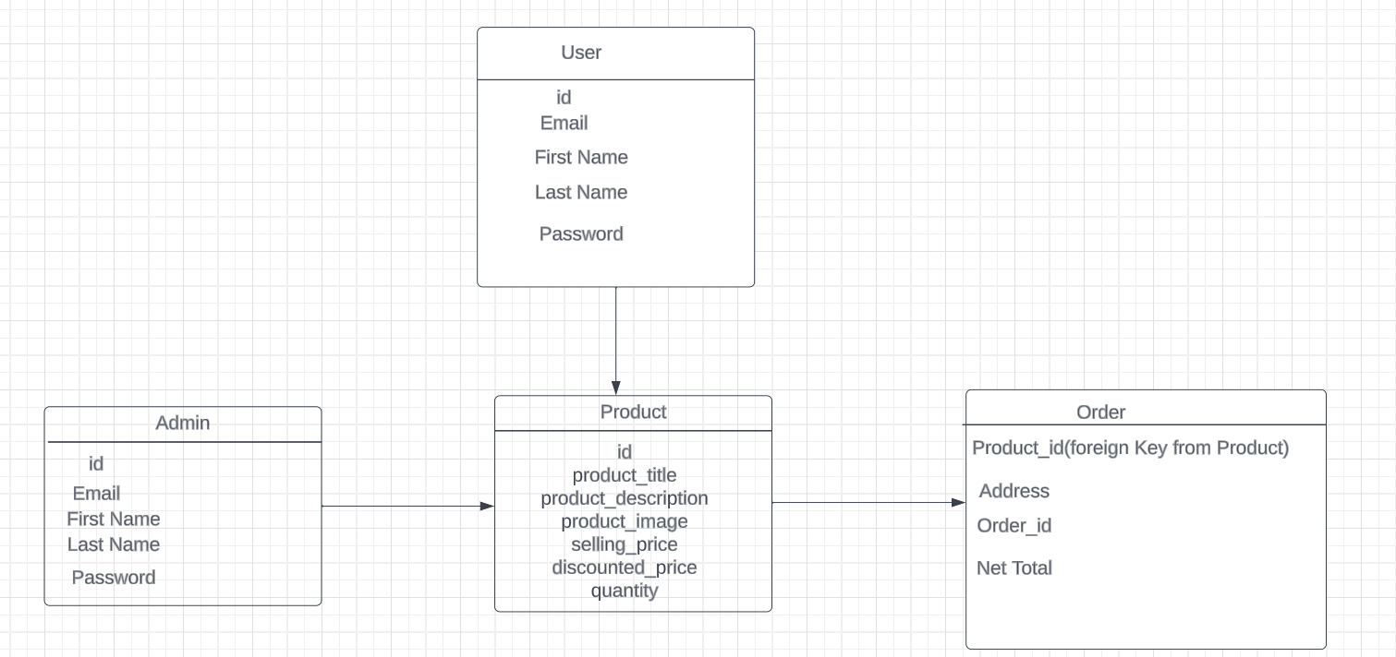
Database Schema

Slide 9
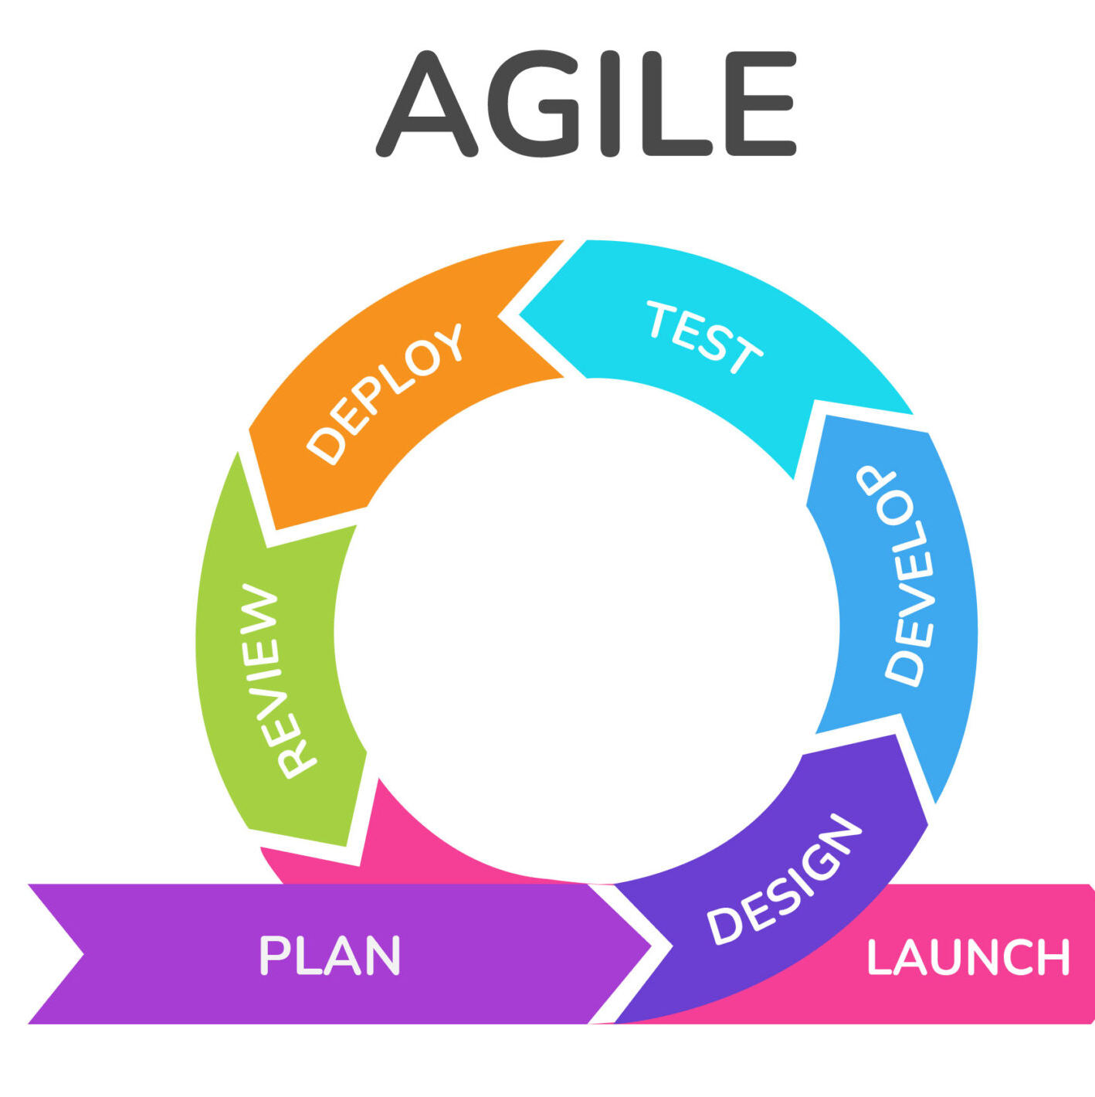
The User Interface is developed/design by using designing tool Figma, to create wireframes.
Framework and Model Used for Website
Django
React
SQLite
Agile model is used for changes and adaption during the development process, accommodating evolving requirement and priorities.

Slide 10
Future Expansion:
Mobile Application Development:
Integration with Payment Gateways:
Enhanced Search and Filtering:

Slide 11
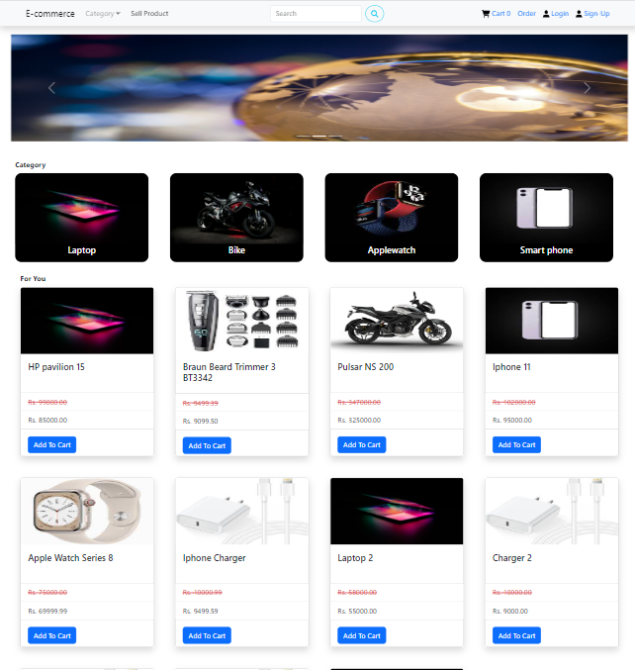
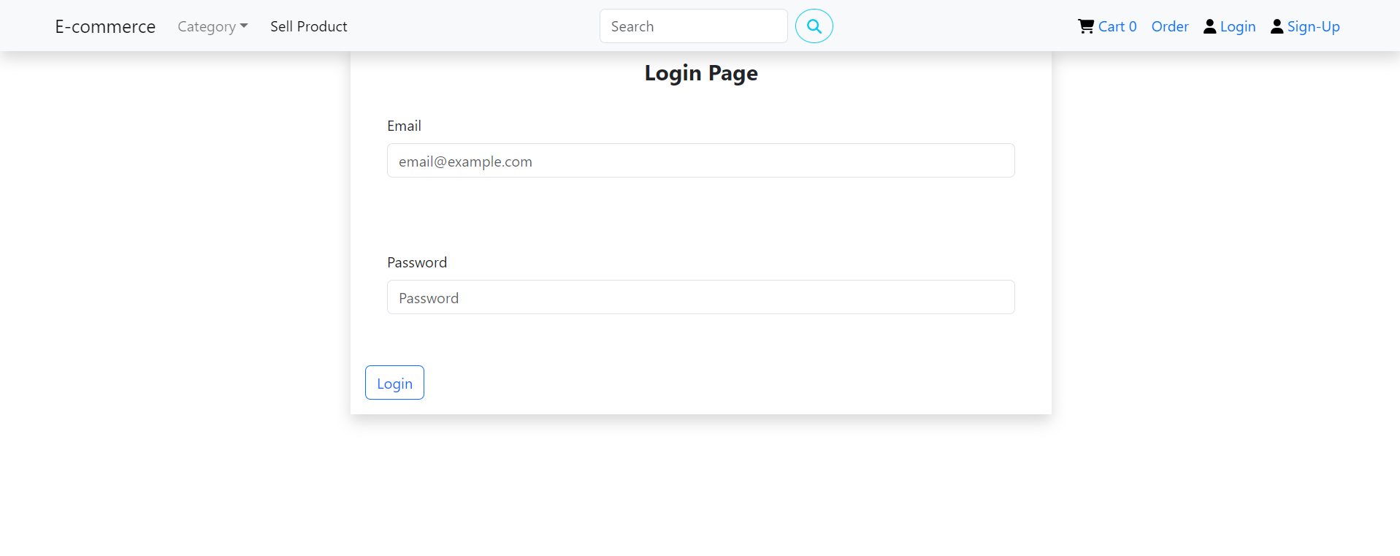
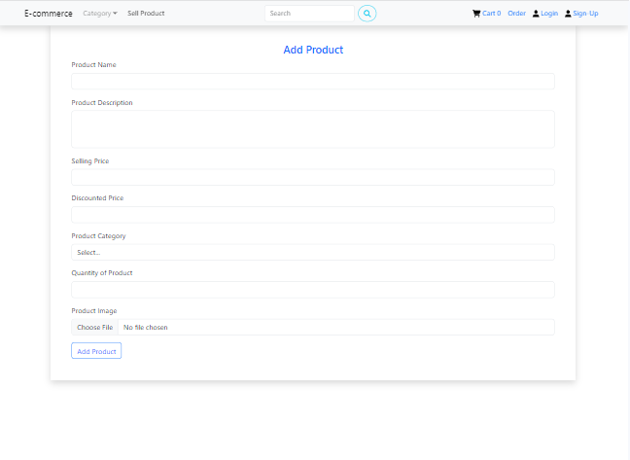
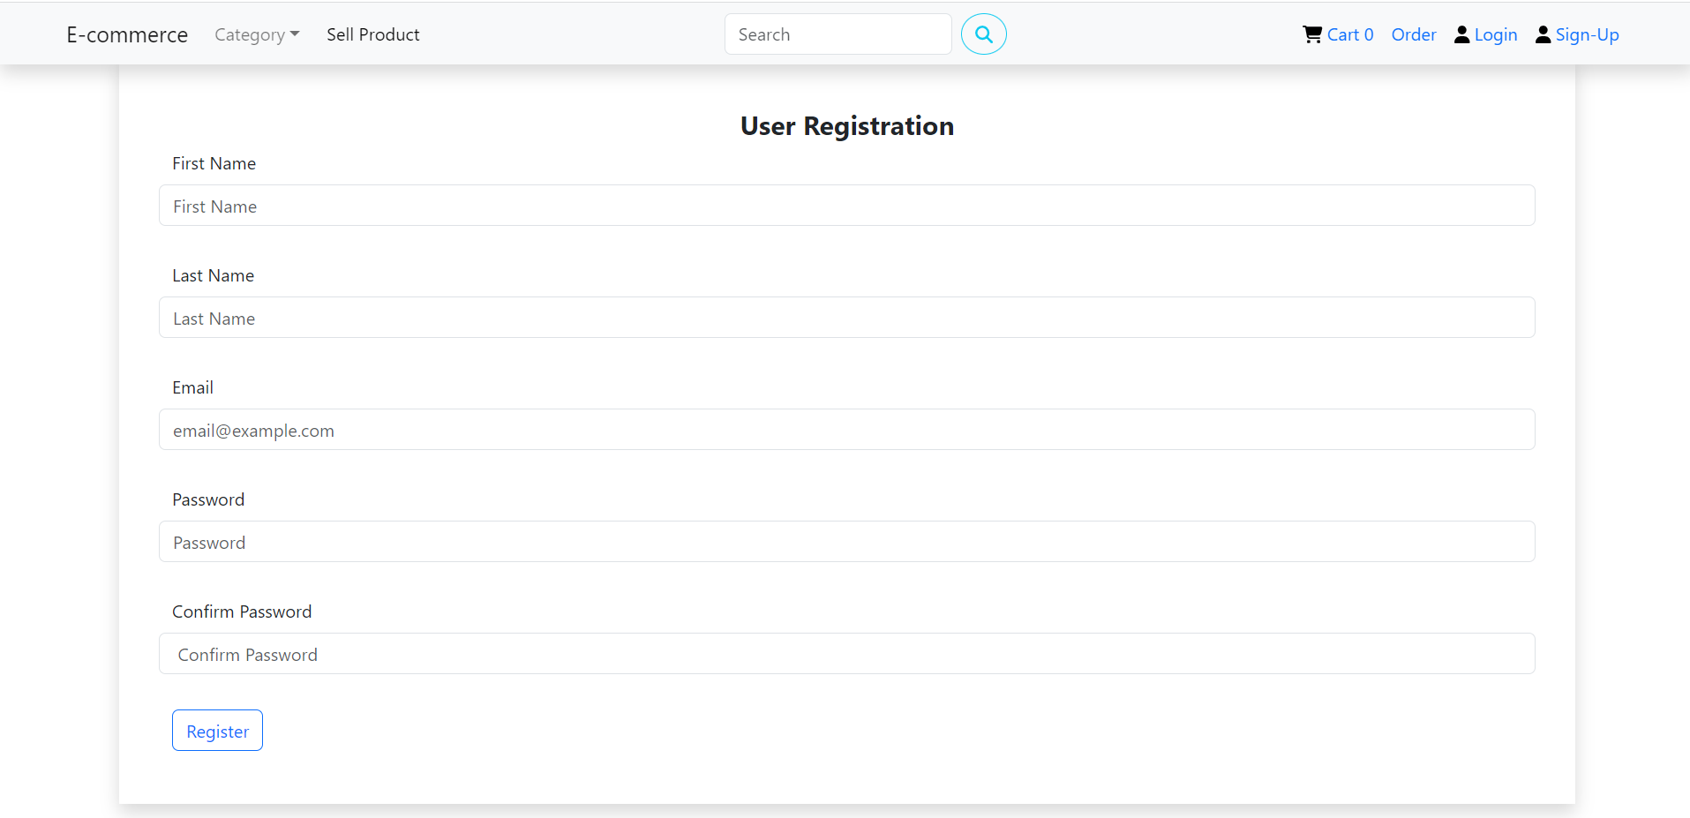
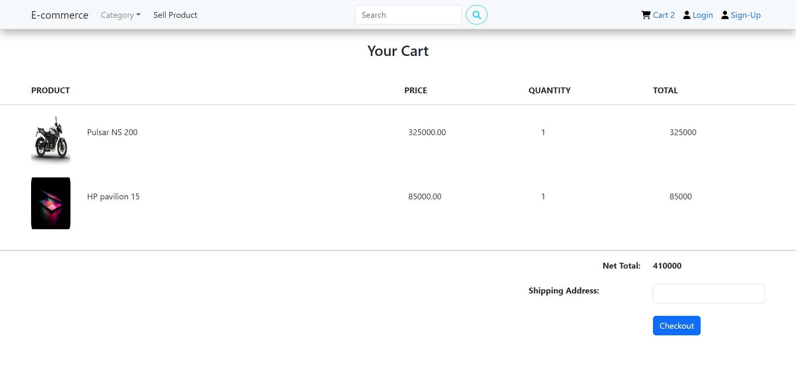
Project Screenshot

Slide 12
Conclusion
In Conclusion, the “SEAM” e-commerce project provides an e-commerce website that makes the buying and selling of product easy as well as fast, by providing fast delivery.
It also address the scarcity of online platforms, prioritizing customer satisfaction.

Slide 13


Thank You
Lopsang Lama
Lopsang.lama@texascollege.edu.np

